Slide 1
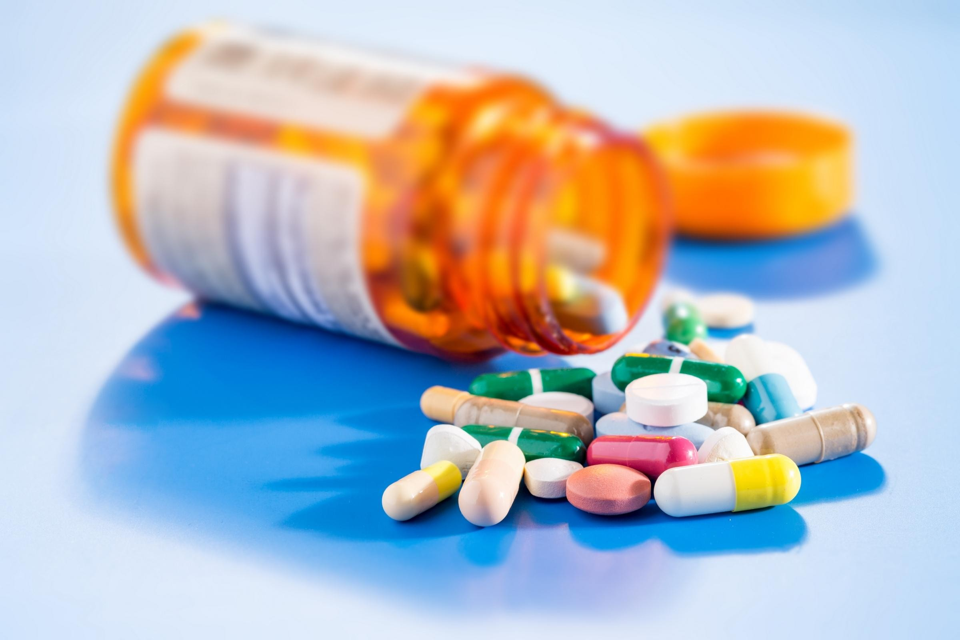

Optum Stratethon Season 4
Team ByteCoders – Aman kumar, Mayank Chittora, Shivam Singhal
SRMIST KTR

Slide 2




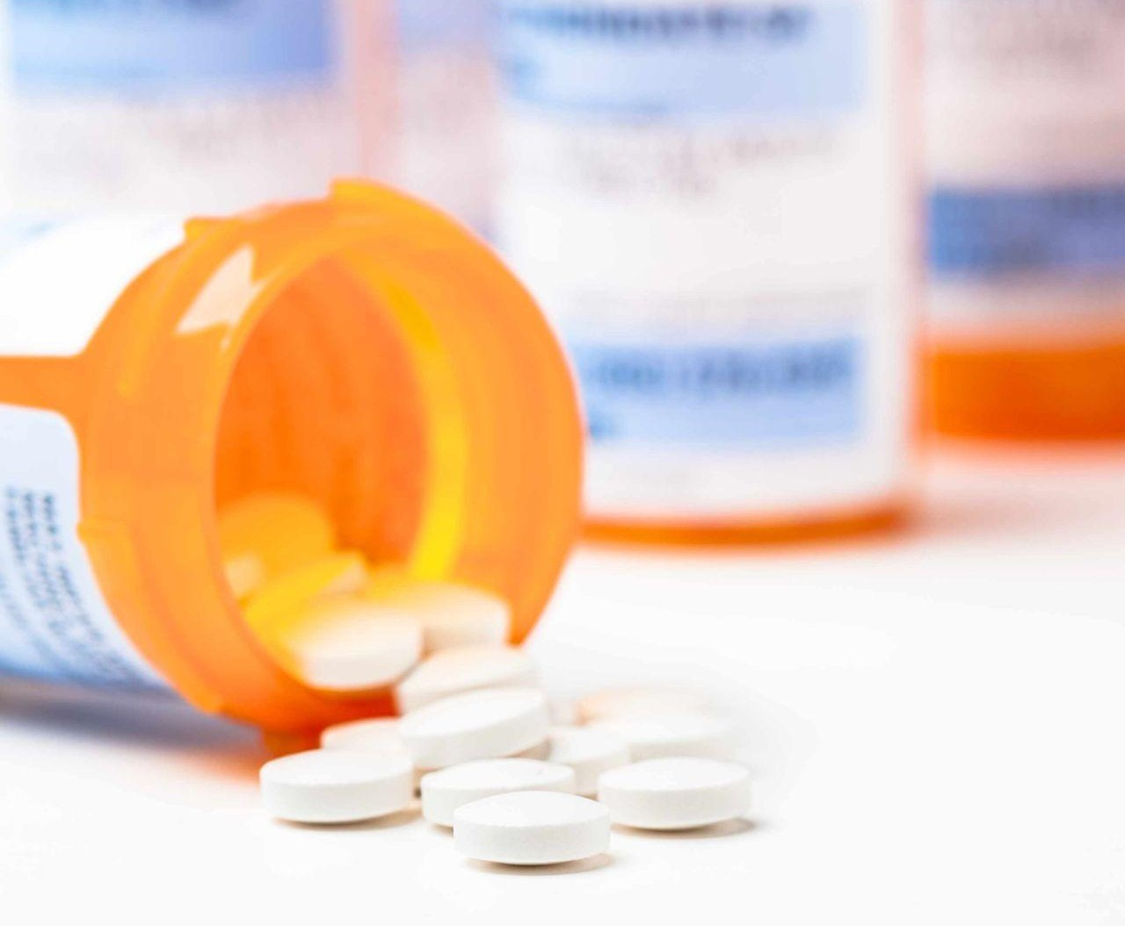


CHRONIC KIDNEY DISEASE (CKD) IDENTIFICATION
Chronic Kidney Disease, acc. to an article published in March 2020, accounts for 4.6% of all-cause mortality, with no signs of rate decline until now as stated by Theo Vos
THE ISSUE
SOLUTION
USE CASE
IMPACT
CKD was ranked 8th among the leading cause of mortality acc. To the metrices of GBD in 2015 and was still climbing. Causes like renal failure due to diabetes , reduced kidney function , in an overwhelming population of our country were the prominent why’s of their demise , in fact civilians were dying inside their homes without knowing the cause , so an accurate and fast identification of CKD might help sooth the numbers as doctors would be able to potentially identify a CKD patient in just a snap of fingers, and this is where KIDSTAT comes into play.

Slide 3





- A fast and reliable app to identify CKD -
KidStat
THE SOLUTION
USE CASE
THE ISSUE
With KidStat Doctors and Citizens can check for CKD with just a blink of an eye.
KidStat can be accessed from anywhere and is cross platform compatible i.e Android , ios and any computer with an internet connection
KidStat is rigorously trained to provide 100% accuracy for identification of chronic kidney disease (CKD) and is very reliable and stable.
IMPACT

Slide 4





1
2
USE CASE
PROBLEM STATEMENT
SOLUTION
IMPACT
Dr. Walker
Mr. James
Head Nephrologist at Mayo Clinic , USA.
Mr. James is a 65 year old man.
Checks for CKD among patients who have kidney issues using the current GFR technique which is of course sluggish
Has a persistent pain below the ribcage where the kidneys are located

Slide 5



1
USE CASES
PROBLEM STATEMENT
SOLUTION
IMPACT
Dr. Smith along with bytecoders have devised a python machine learning model which on providing relevant patient information like race,gender,age etc can predict whether a patient can be non adherent in coming future
Along with this a detailed analysis of the patient mass is also performed that gives an overview for the base of the above prediction

Slide 6
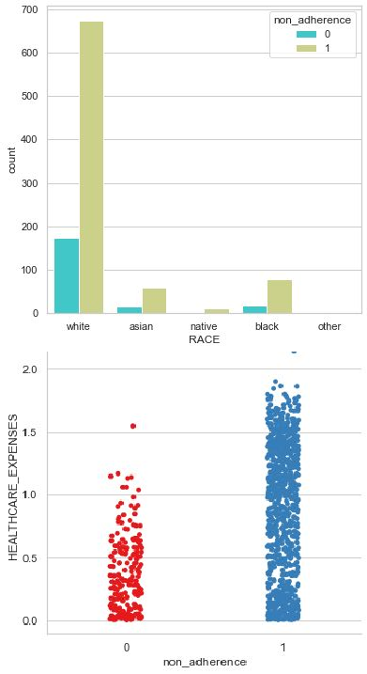
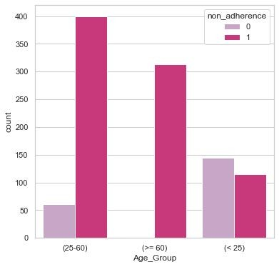
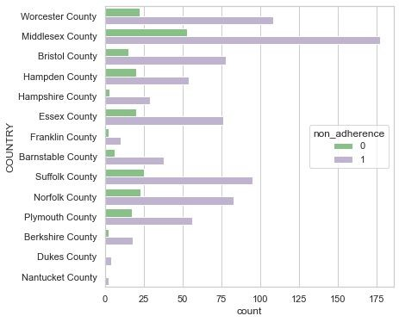
DETAILED ANALYSIS OF NON-ADHERENCE
USE CASES
PROBLEM STATEMENT
SOLUTION
IMPACT

Slide 7


2
PROBLEM STATEMENT
SOLUTION
IMPACT
USE CASES
Lisa’s medication is in constant watch as she uses medcall the online reminder, tracker for her meds and easy appointment scheduling, all of this integrated in a single platform.
Medcall aims at reduction of non-adherence in medication by simple ways like scheduling a reminder call and a whatsapp message for further check.

Slide 8




IMPACT & UNIQUE SELLING POINT (USP)
250,000
80% 30%
DEATHS
Is it OK to miss a dose?
Adherence to your medications (that is, taking them exactly as prescribed by your doctor) is very important. Here's why.
When you take your medication on a regular basis, your body reaches what is known as “steady state” .
You can tie your drug doses with a daily call reminders like breakfast time, after a shower, or when you get ready for bed.
Keep yourself updated with medications prescription reﬁll date and time.
MEDCALL is a unique service that doesn't just remind you on call for taking medication but also schedules appointments as well as reminds you via WhatsApp.
USE CASES
STATEMENT
PROBLEM
IMPACT
ABOUT

Slide 9





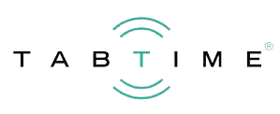


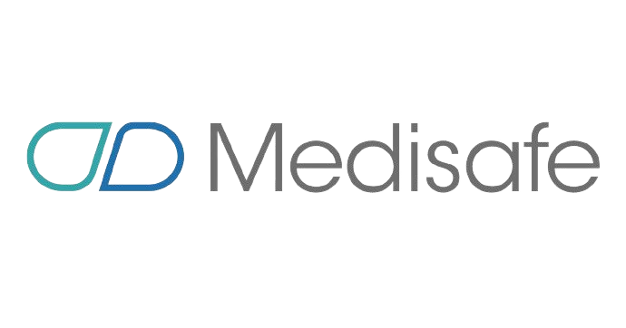
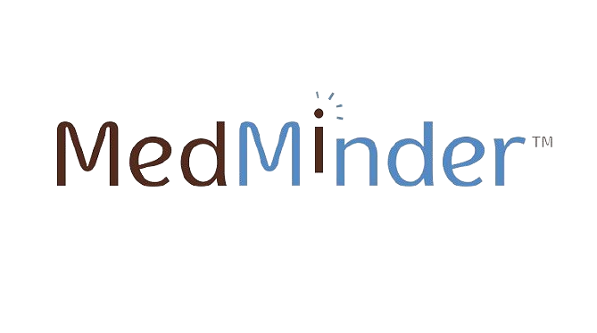

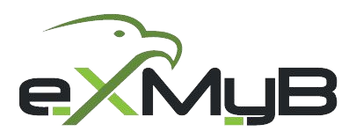

Comparative Metrics
250,000
80% 30%
DEATHS
No appointments booking system
Appointments booking system
Medicine Reminder
USE CASES
STATEMENT
PROBLEM
IMPACT
ABOUT
No Medicine Reminder

Slide 10
IMPORTANT LINKS
250,000
80% 30%
DEATHS
Project link : https://med-call.herokuapp.com/
Github :
https://github.com/Mayank18-dotcom/Bytecoders-Stratethon
EDA Automator : https://share.streamlit.io/iamamankumar22/eda-automator/m ain/app.py
USE CASES
STATEMENT
PROBLEM
IMPACT
ABOUT

Slide 11


THANK YOU
Aman kumar
Mayank Chittora Shivam Singhal

